Slide 1
NatSteel Safety Journey

Slide 2
Vision for Safety
NatSteel vision for safety is,
“Be the Leading Light in Safety, Health & Environment”

Slide 3
Safety Contact
NatSteel practice to start meetings and communications with safety contact

Slide 4
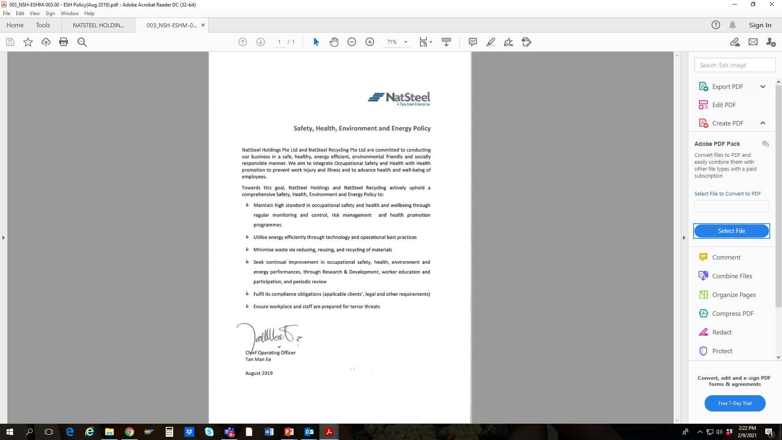
Safety, Health, Environment & Energy Policy

Slide 5
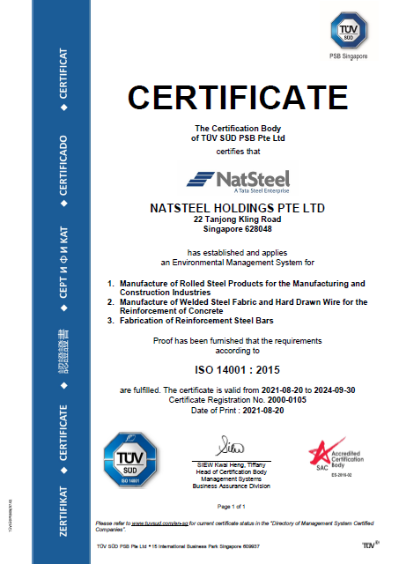
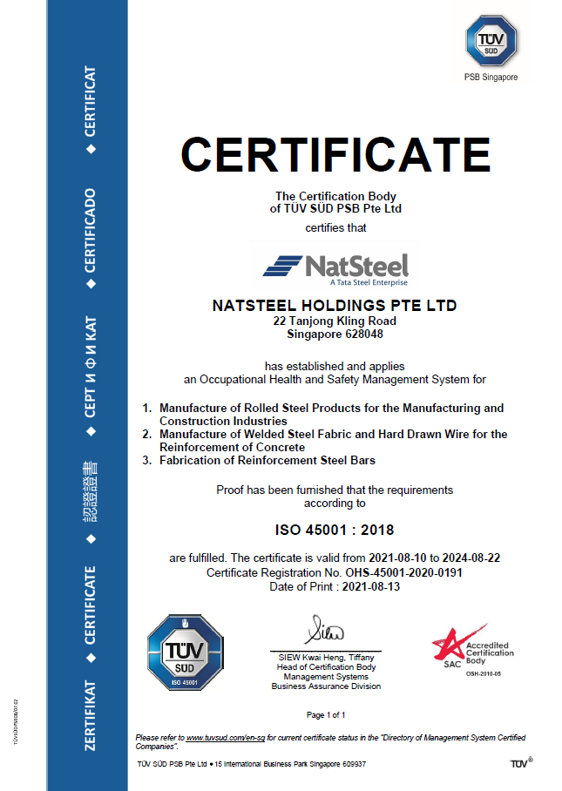
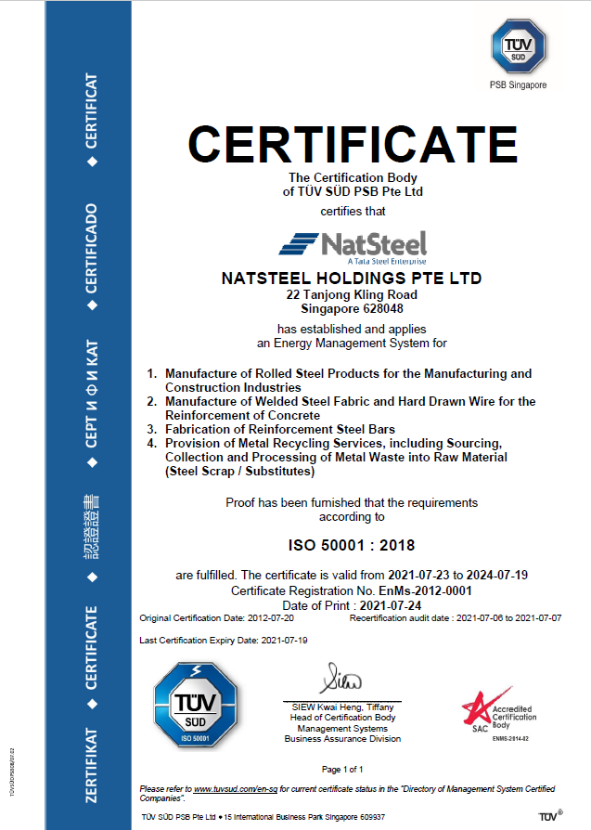
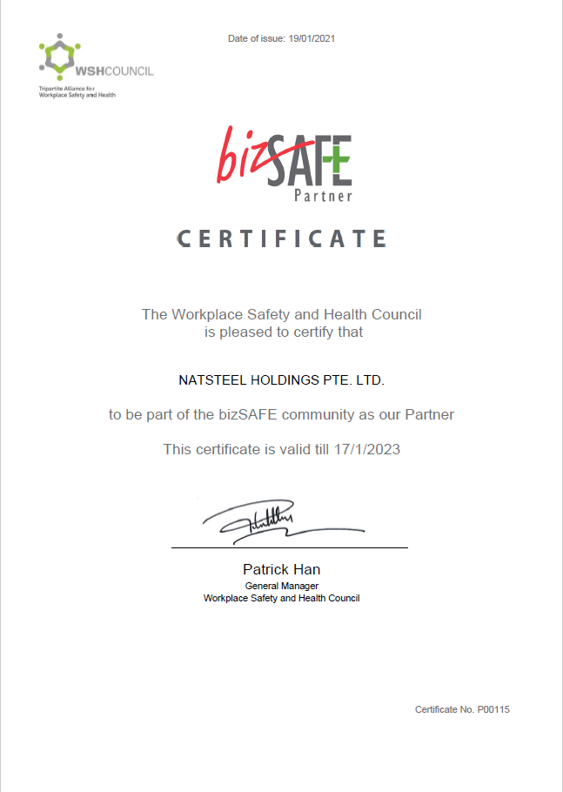
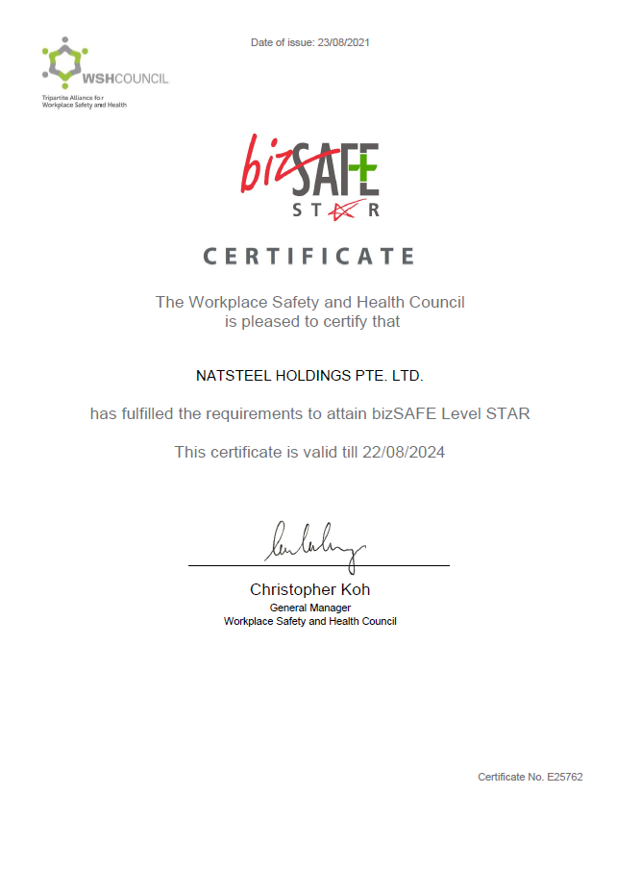
Accolades: ISO & bizSAFE Certifications
ISO 14001:2015
ISO 45001:2018
ISO 50001:2018
bizSAFE Partner
bizSAFE Star

Slide 6
NatSteel 9 Safety Principles
All accidents are preventable
Working safety is everyone’s responsibility
Management is responsible for preventing injuries
Working safely is a condition of employment
All employees must be trained to work safely
Ensuring our subcontractors/partners are committed to safety principles
Regular safety audits must be conducted
Promoting safety is an integral part of our internal communication
Gaps in safety must be corrected promptly

Slide 7


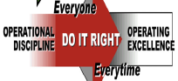





NatSteel Safety Journey
Leadership Competency
Building Program
Job Cycle Check - JCC
Operational Discipline - OD
Safety Observation Program - STOP
Process Safety Management - PSM
Total WSH
Fatality Risk Containment Program - FRCP
Contractor Safety Management - CSM
Felt Leadership Training
2008
(Engaged DUPONT as Safety Consultant)
2021

Slide 8

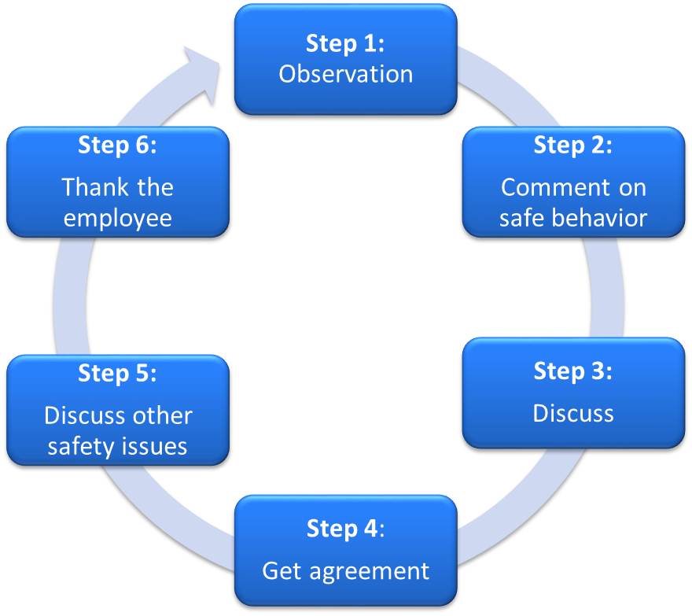
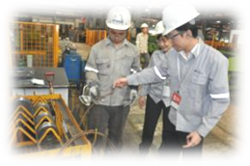
Safety Observation Program
STOP is a 6-step process of communication, to cultivate safety awareness and positive behaviors.
Six key areas:
Reactions of people
Personal protective equipment
Positions of people
Tools and equipment
Procedures
Orderliness Standards

Slide 9
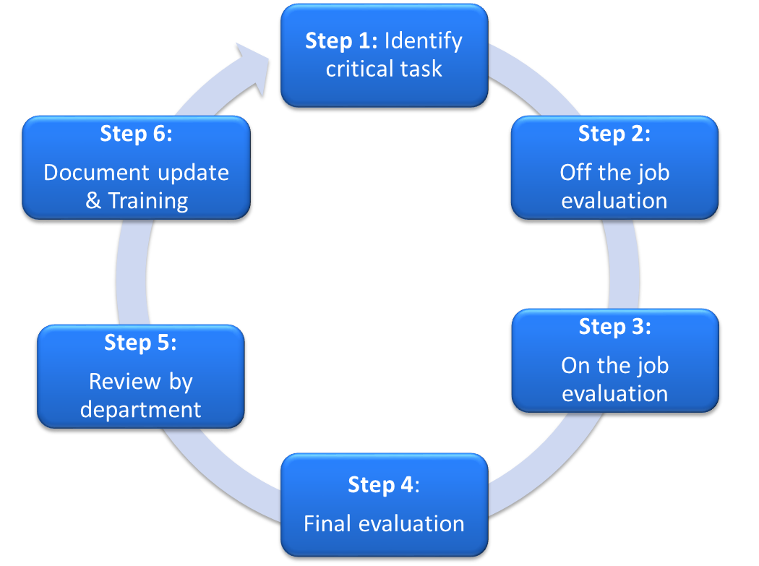
Job Cycle Check
JCC is a 6-step process to validate the existing safe work procedure and the understanding of workforce

Slide 10
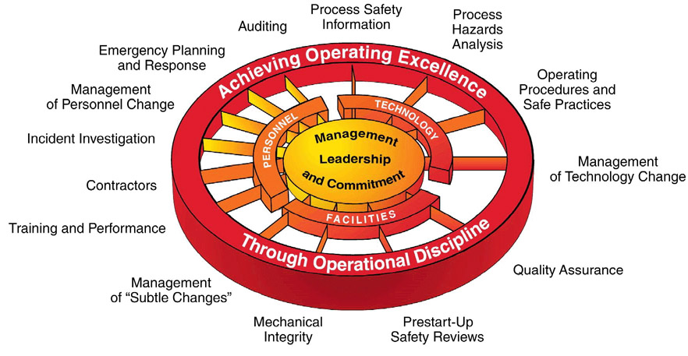
Process Safety Management
PSM helps to prevent process related incidents

Slide 11
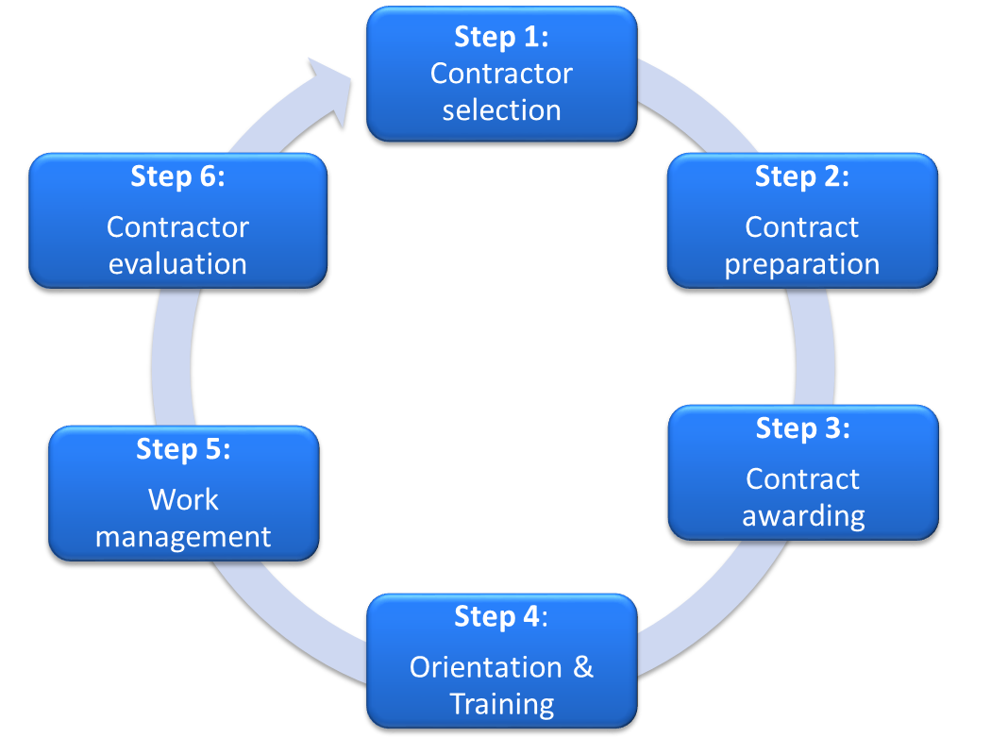
Contractor Safety Management
CSM helps to manage contractors effectively

Slide 12
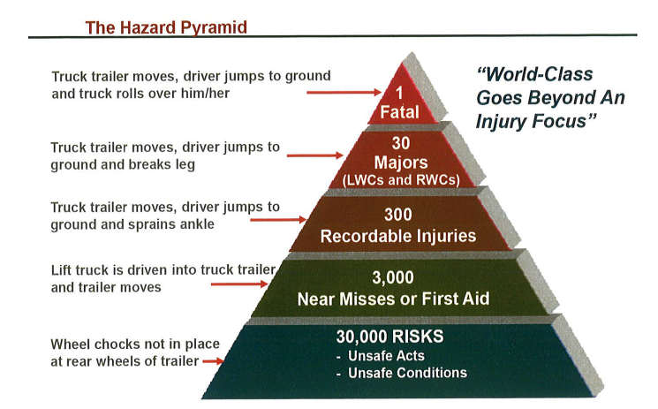
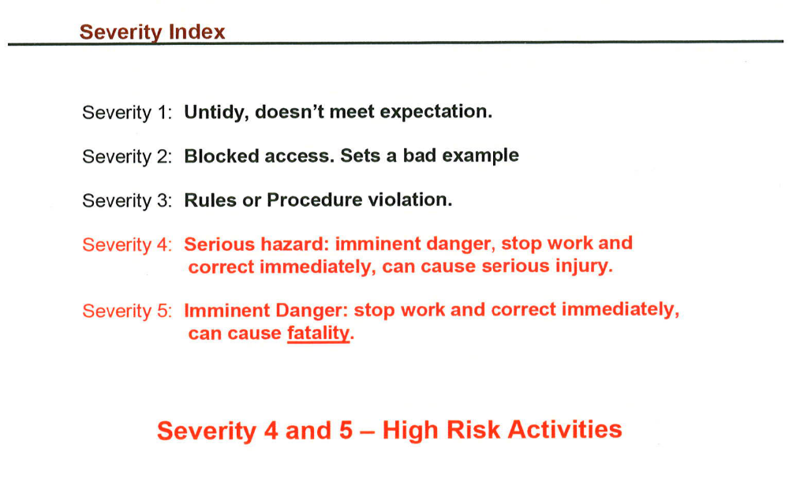
Fatality Risk Containment Program
FRCP helps to eliminate fatality potential unsafe acts and unsafe conditions
Understanding of the hazard pyramid and its association with risk containment
Identifying hazards and classifying the severity

Slide 13
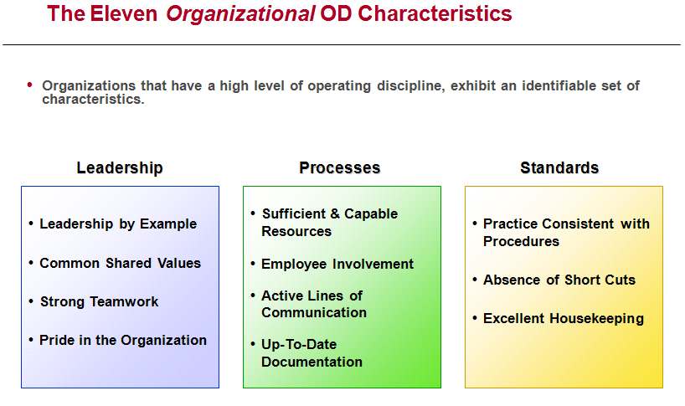
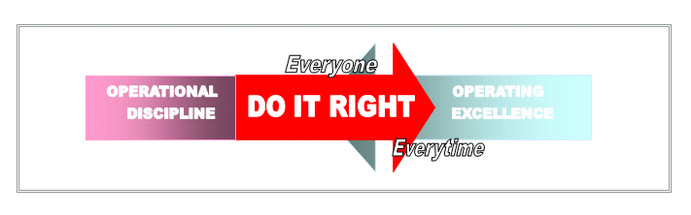
Operational Discipline
OD assessment helps to evaluate the overall safety deployment

Slide 14
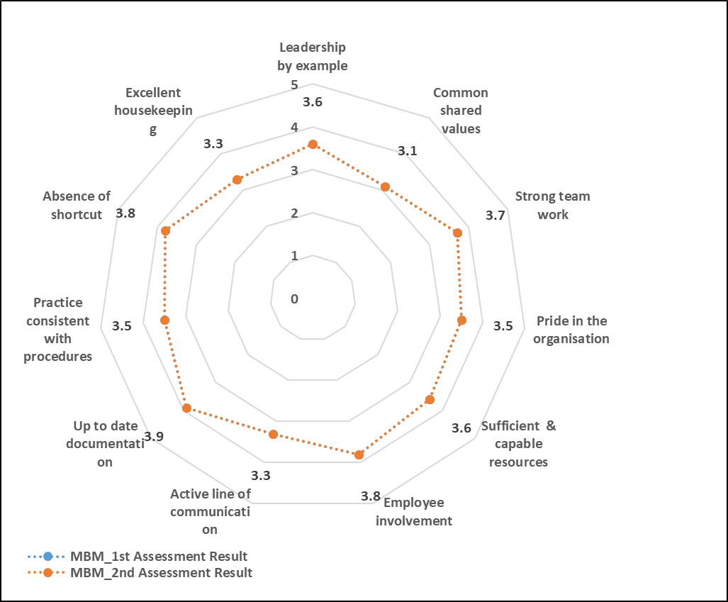
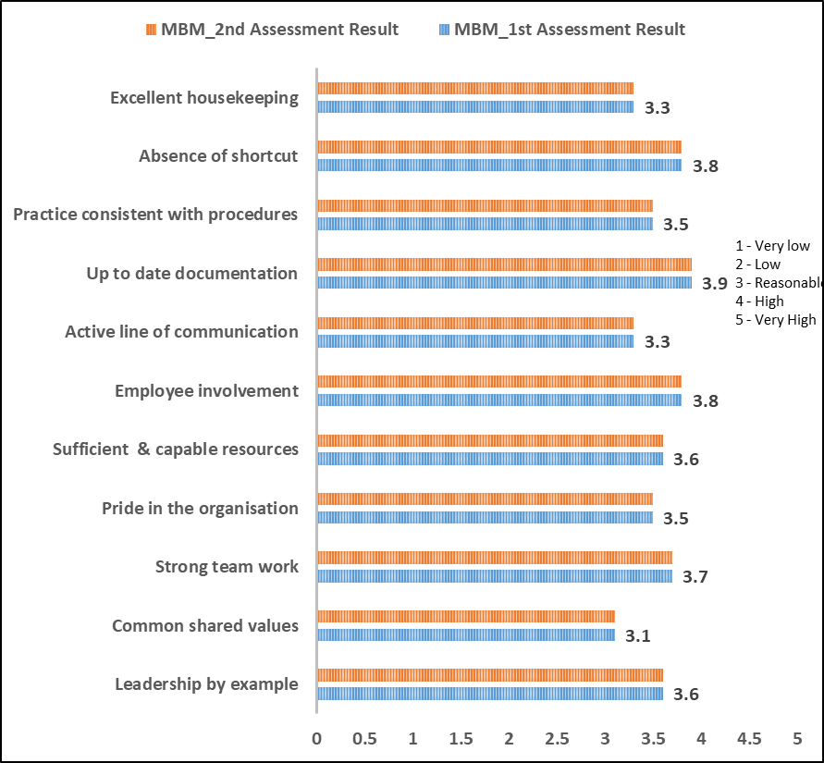
MBM OD ASSESSMENT RESULT
OD Assessment Summary
No progress, need to focus on OD

Slide 15
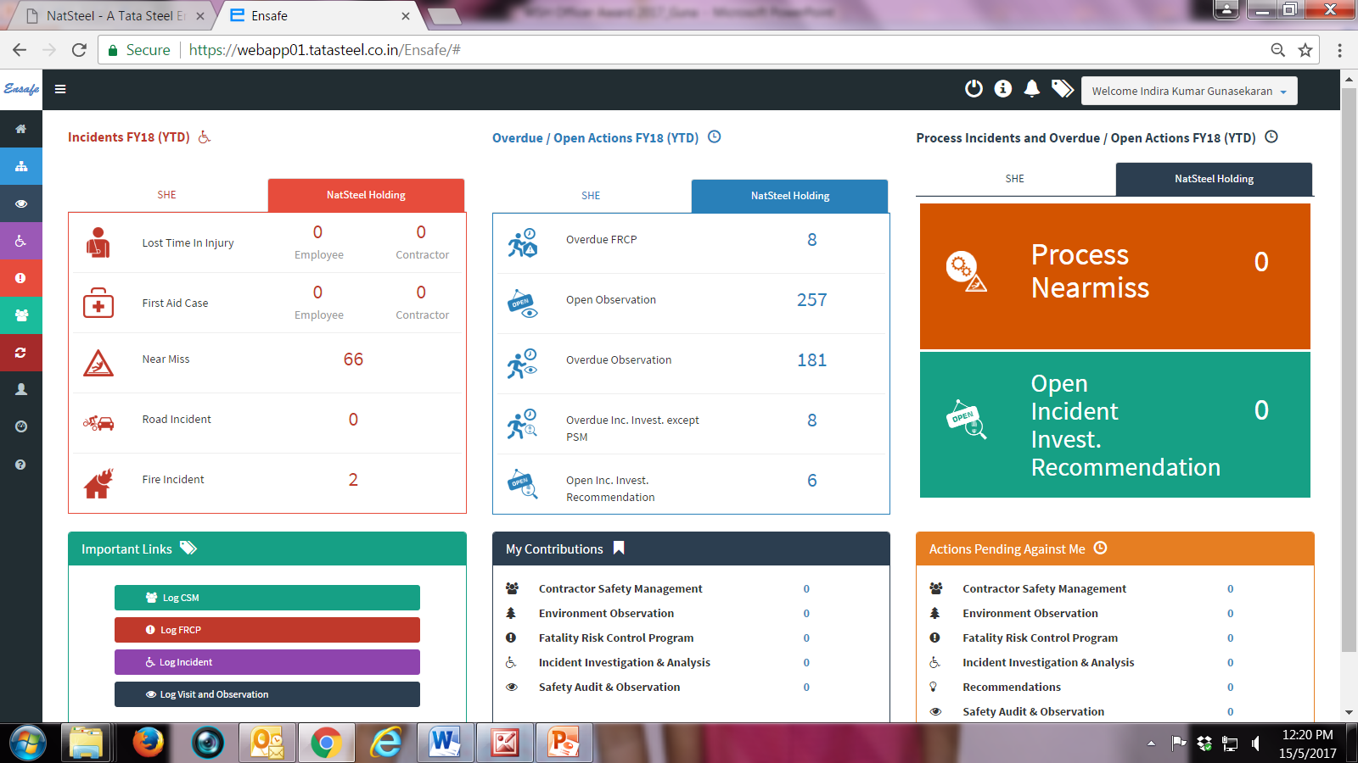
ENSAFE – IT Platform for Safety Programs
Modules
  Safety Observation and Audits (SOA)
  Incident Investigation (II)
  Fatality Risk Containment Audit (FRCP)
  Management of Change (PSM)
  Contractor Safety Management (CSM)
  Job Cycle Check (JCC)
  Risk Containment (RC)
  Consequence Management (CM)

Slide 16



NatSteel Safety Organisation Structure
Apex Safety Council
SHE Department
Process Safety Management
DIC – Upstream
MSP
MBM
NSR
Maintenance
DIC – Downstream
CAB
MESH
CAGING
Maintenance
DIC – Support Services
LTM
WD (ICD,PPS)
GSD (CM,ISU)
DIC – Corporate
HR
IT
FINANCE
OTHERS
Contractor Safety Management
Incident Investigation
Energy & Environment
Total Workplace Safety & Health
Governance and Competency
Sub Committees
Execution and Monitoring
Divisional and Area Implementation Committees

Slide 17
NatSteel Six Safety Strategies
Safety Leadership development
Organizational Safety Competency and Capability Improvement
Contractor Safety Risk Management
Road Safety Risk Management
Process Safety Management (PSM), Integrated Emergency Response, Infrastructure Integrity Management
Occupational Health / Industrial Hygiene (OH/IH)

Slide 18
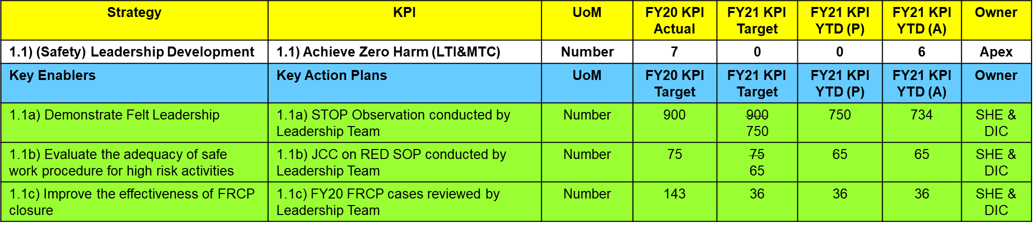
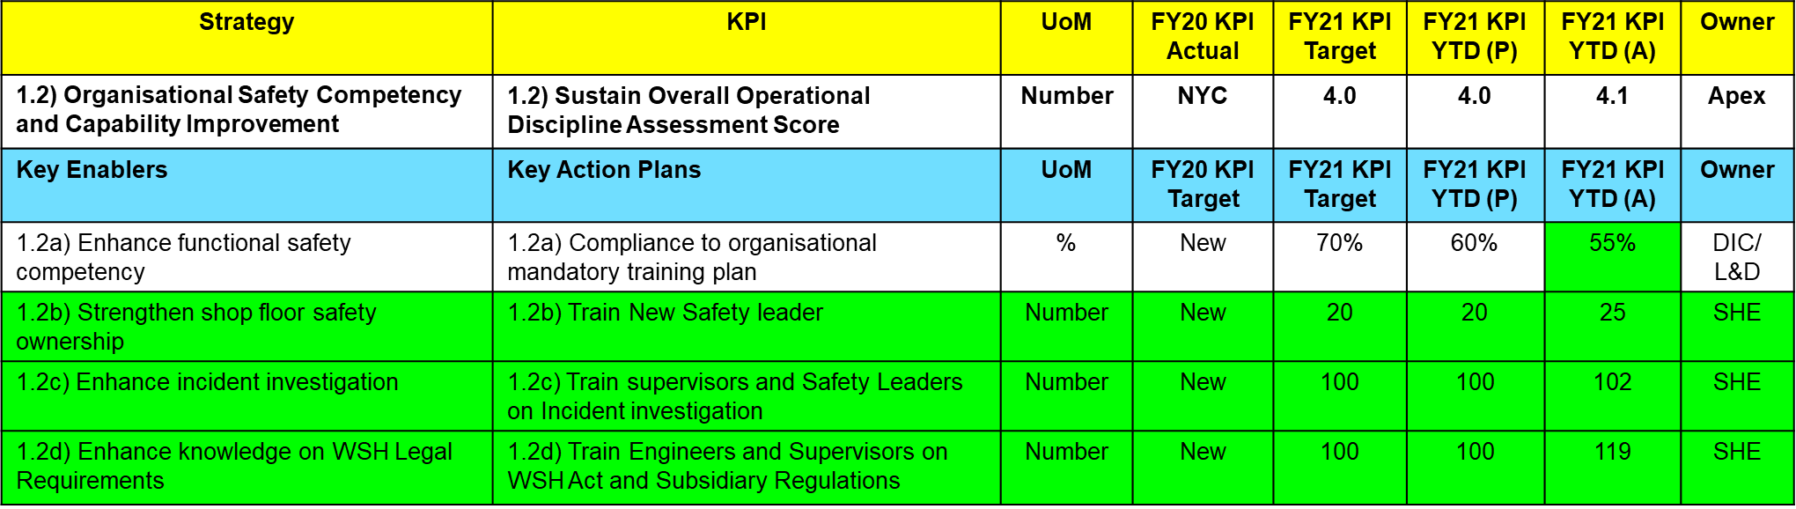
FY21 Safety ABP

Slide 19
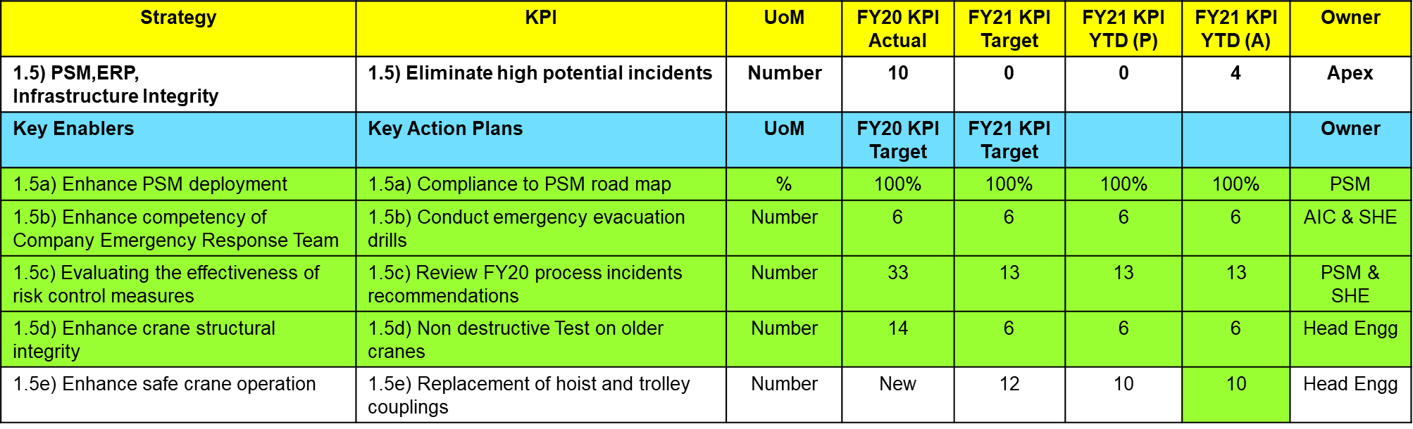
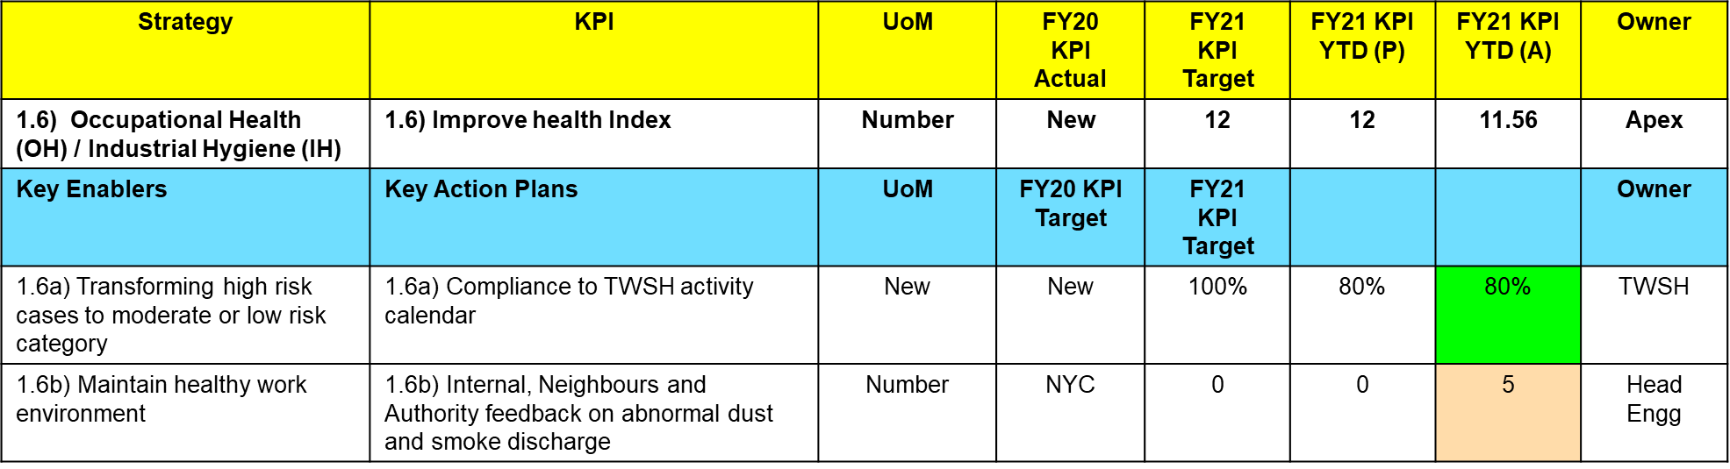
FY21 Safety ABP

Slide 20
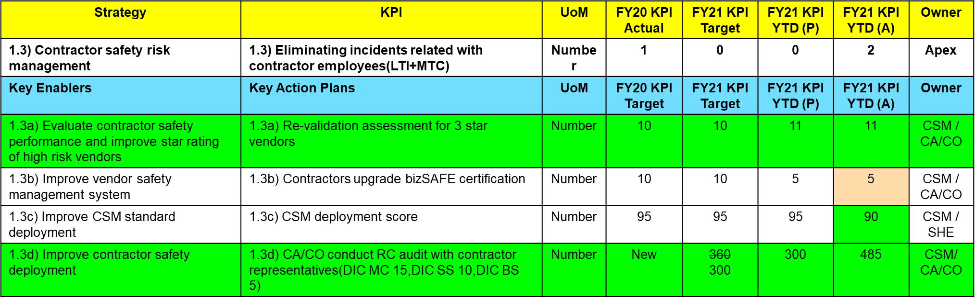
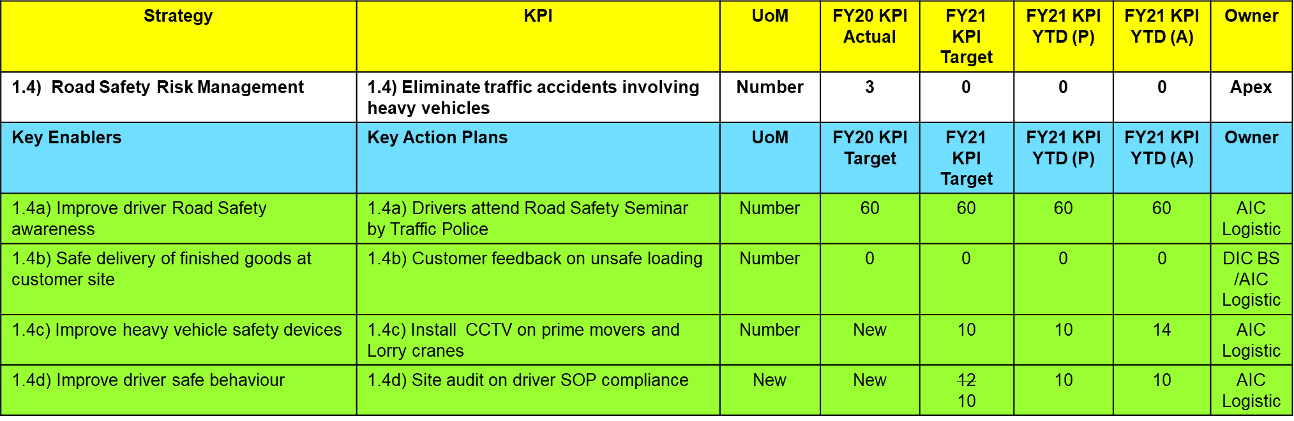
FY21 Safety ABP

Slide 21
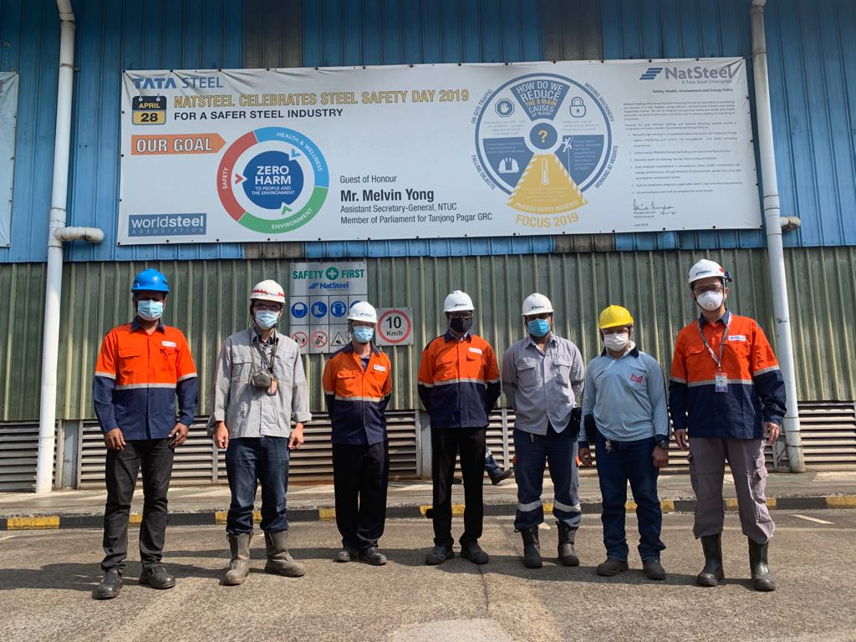
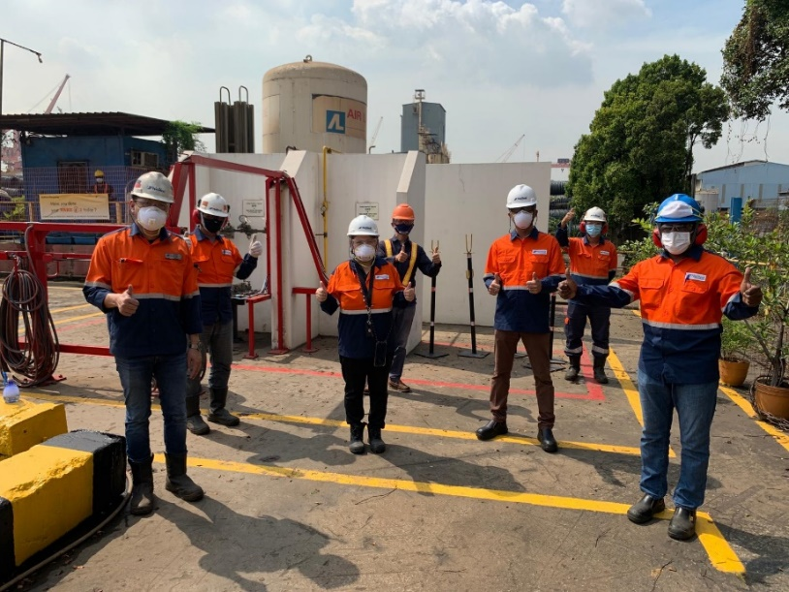
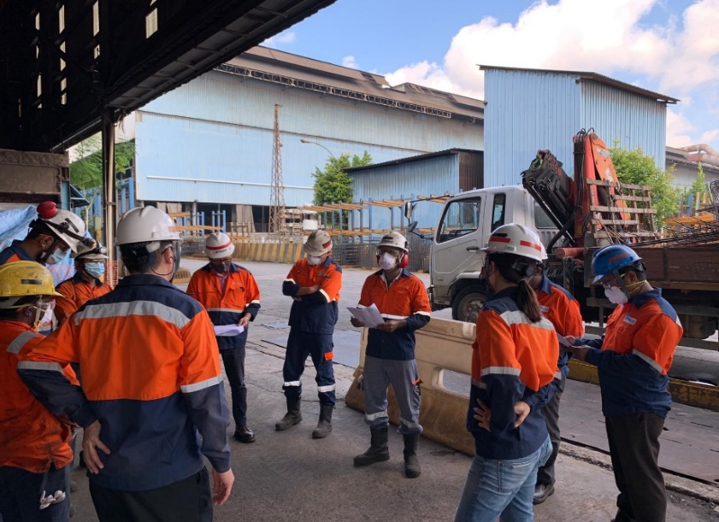
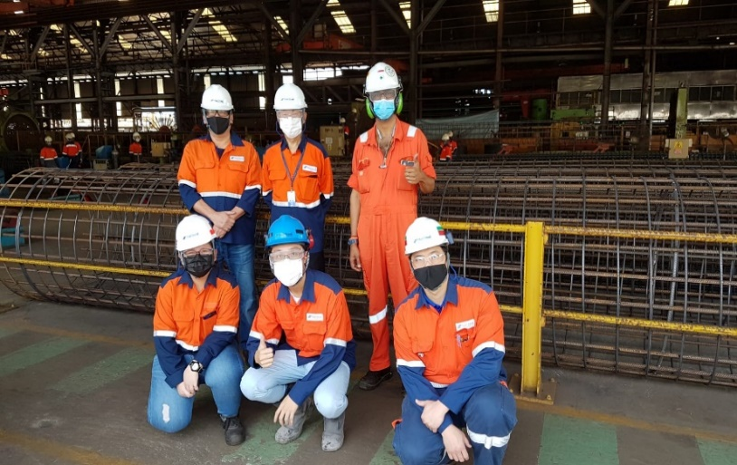
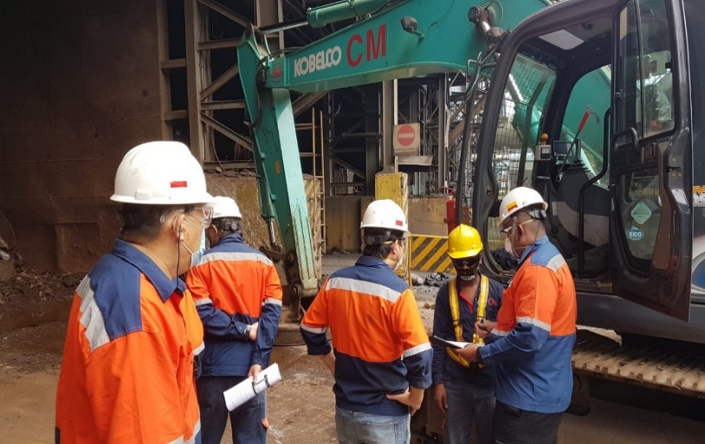
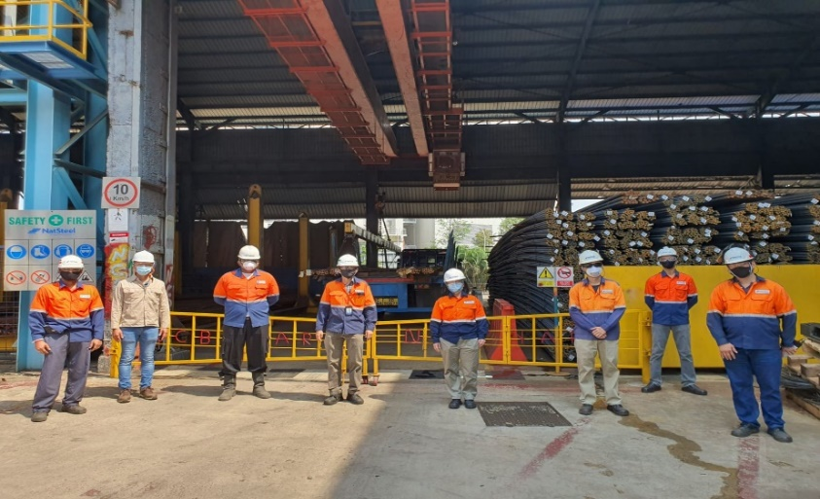
Safety Promotion: Steel Safety Day
Senior Leaders & Contractor representative participate in site audit

Slide 22
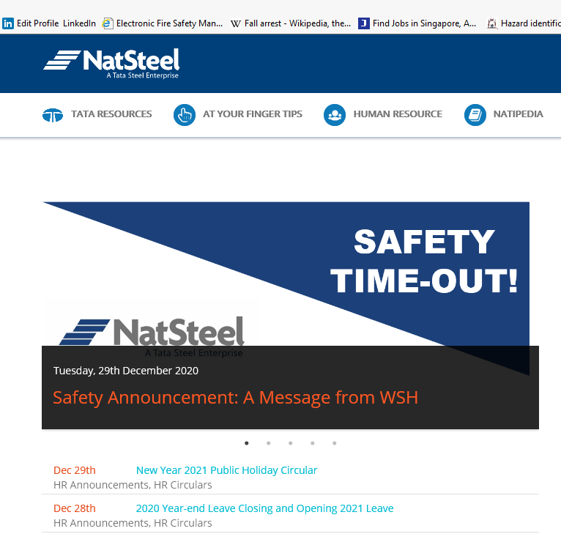
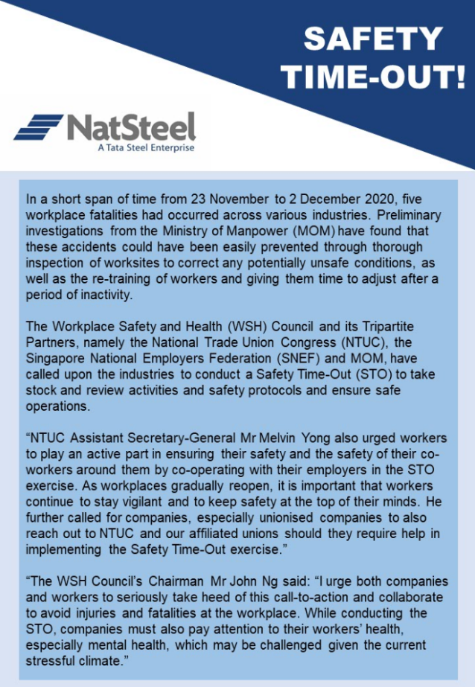
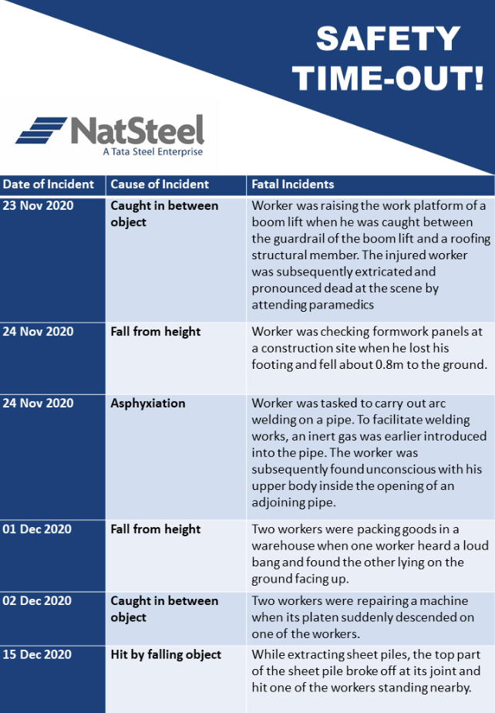
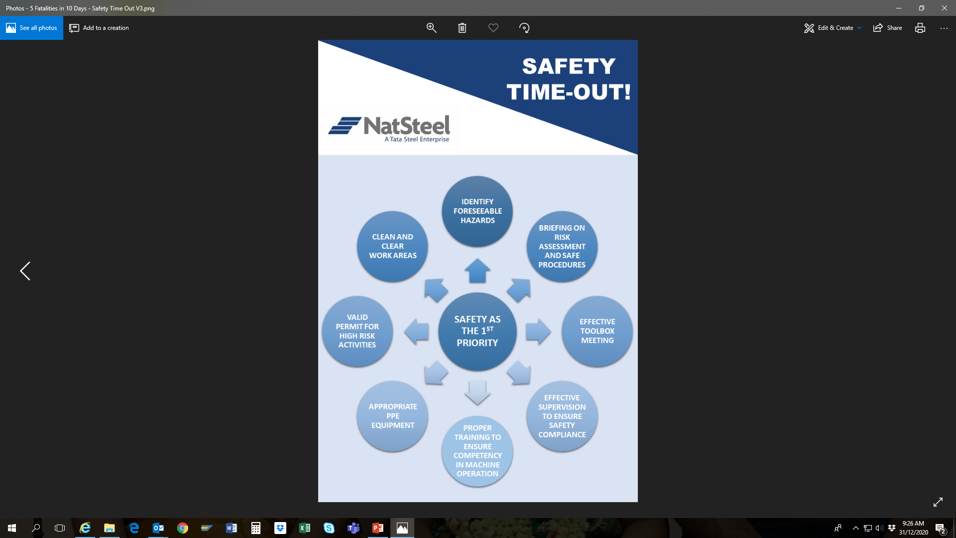
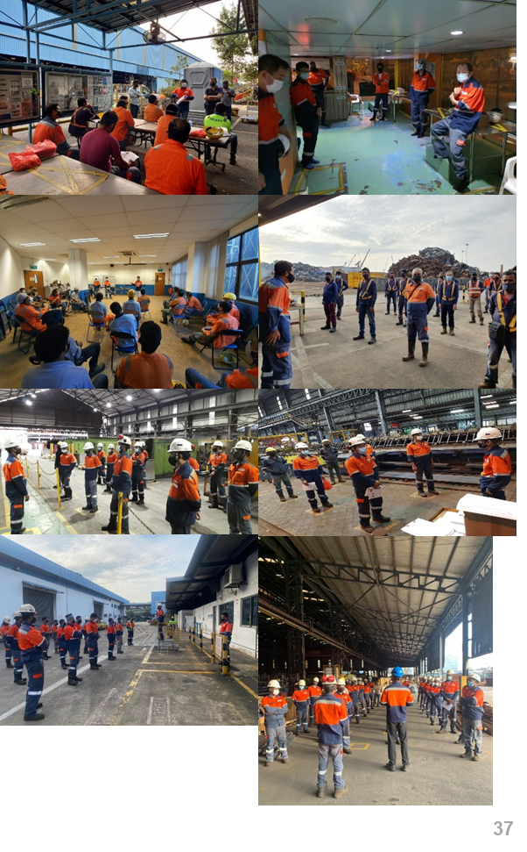
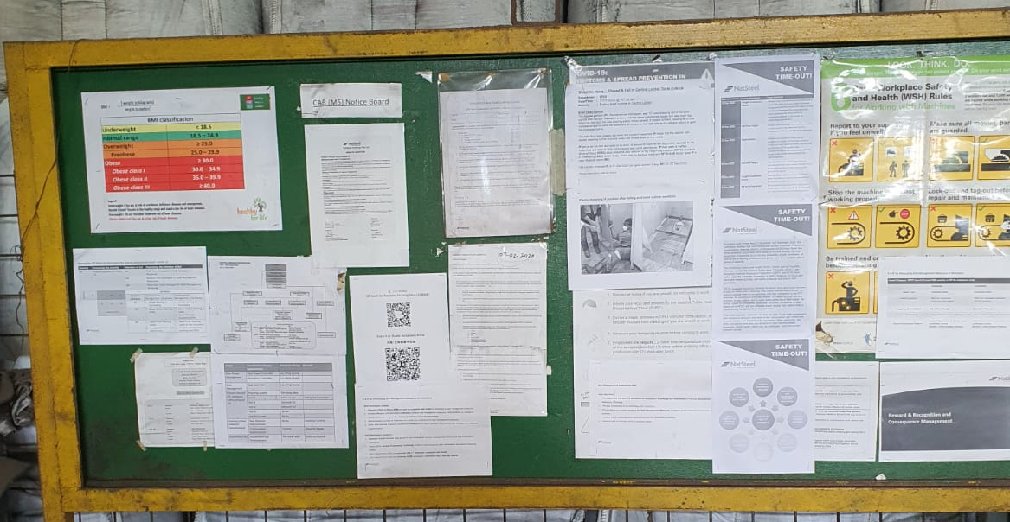
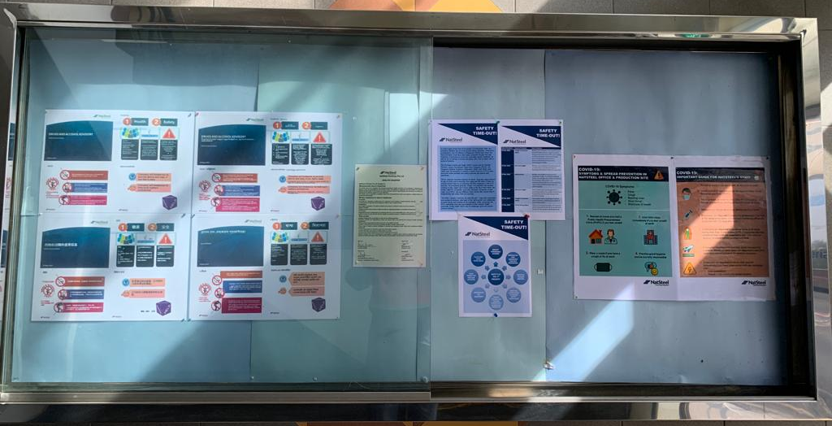
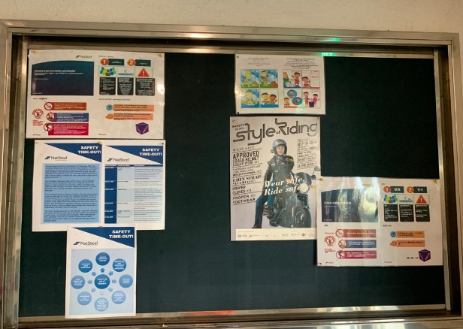
Safety Promotion: Safety Time-Out
Employees & Contractors were briefed on recent spate of external fatal accidents

Slide 23

Health Promotion: Health Talks

Slide 24
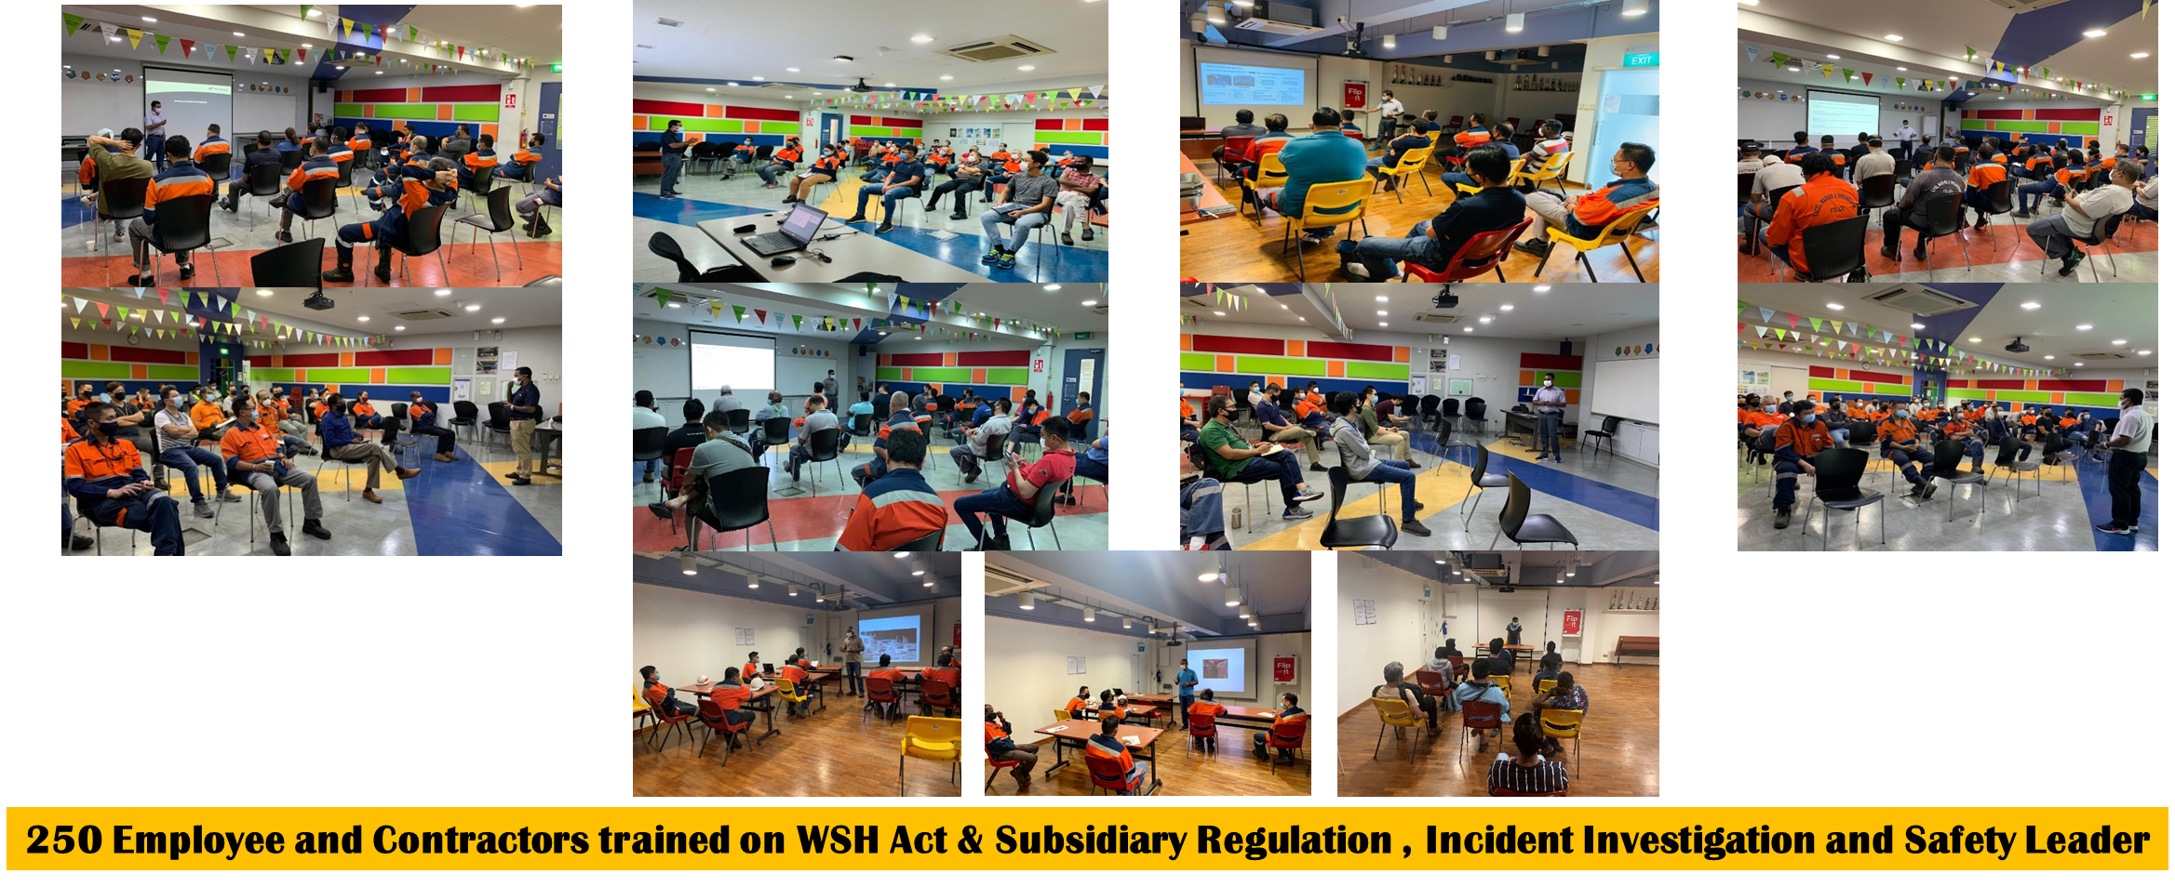
Enhance Safety Competency: Safety Trainings

Slide 25
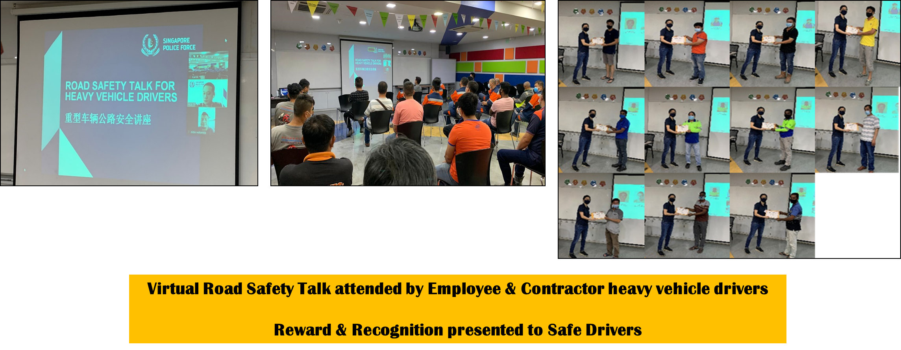
Enhance Safety Competency:
Road Safety Talk by TP

Slide 26
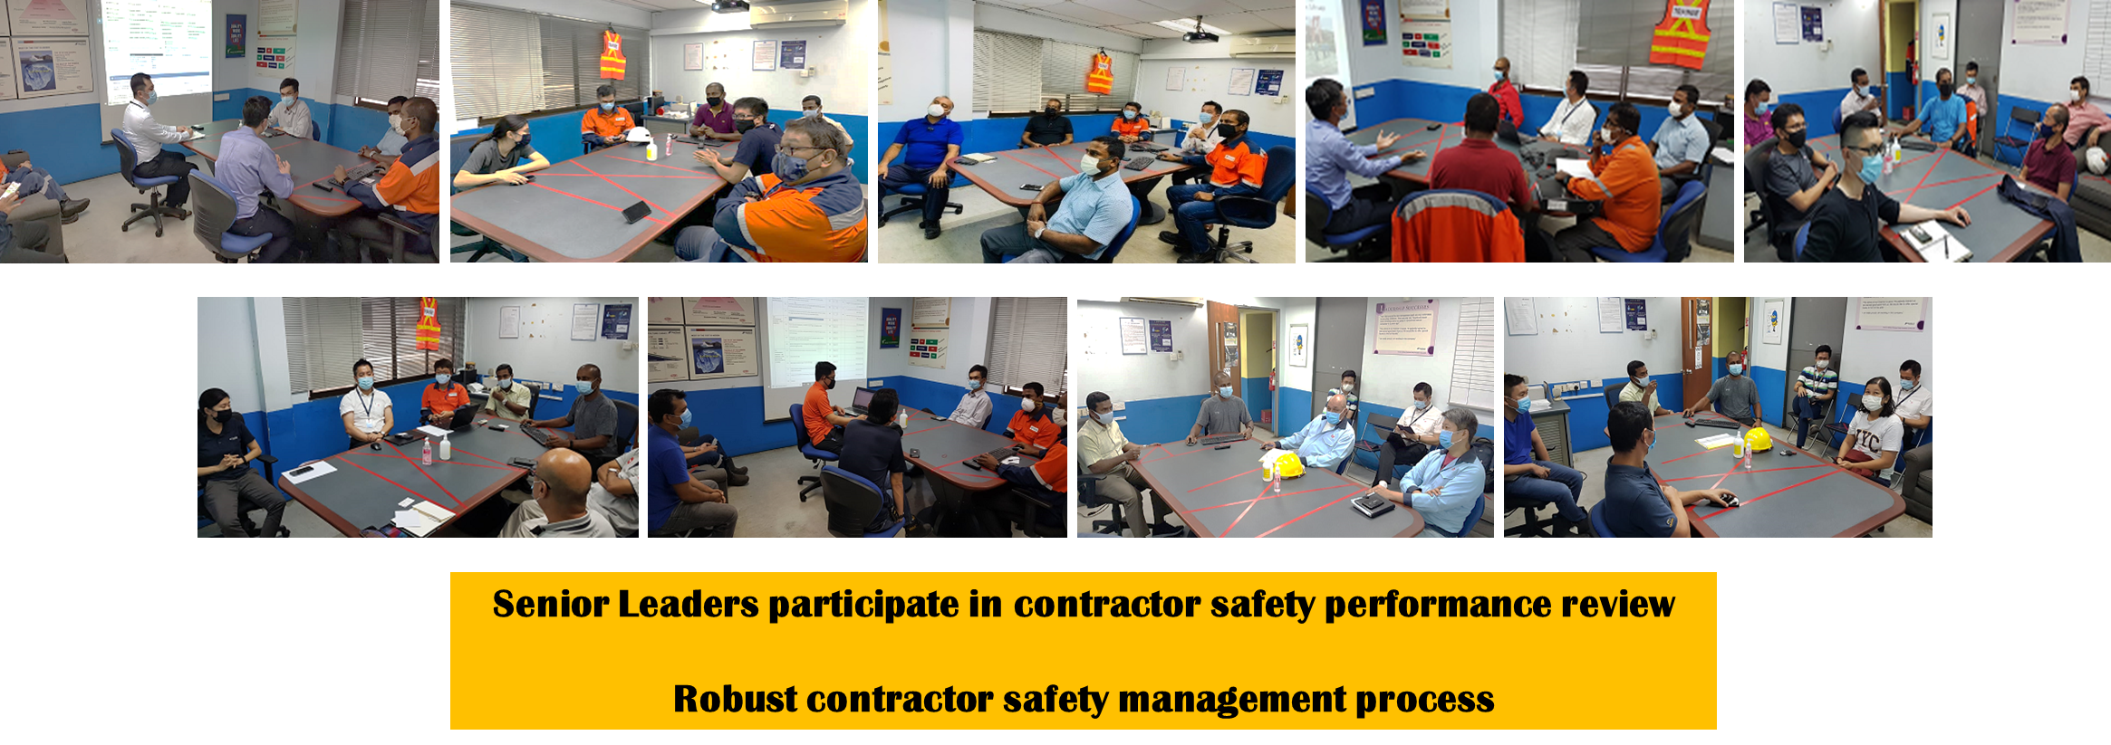
Nurturing Contractors:
Contractor Annual Safety Performance Review

Slide 27
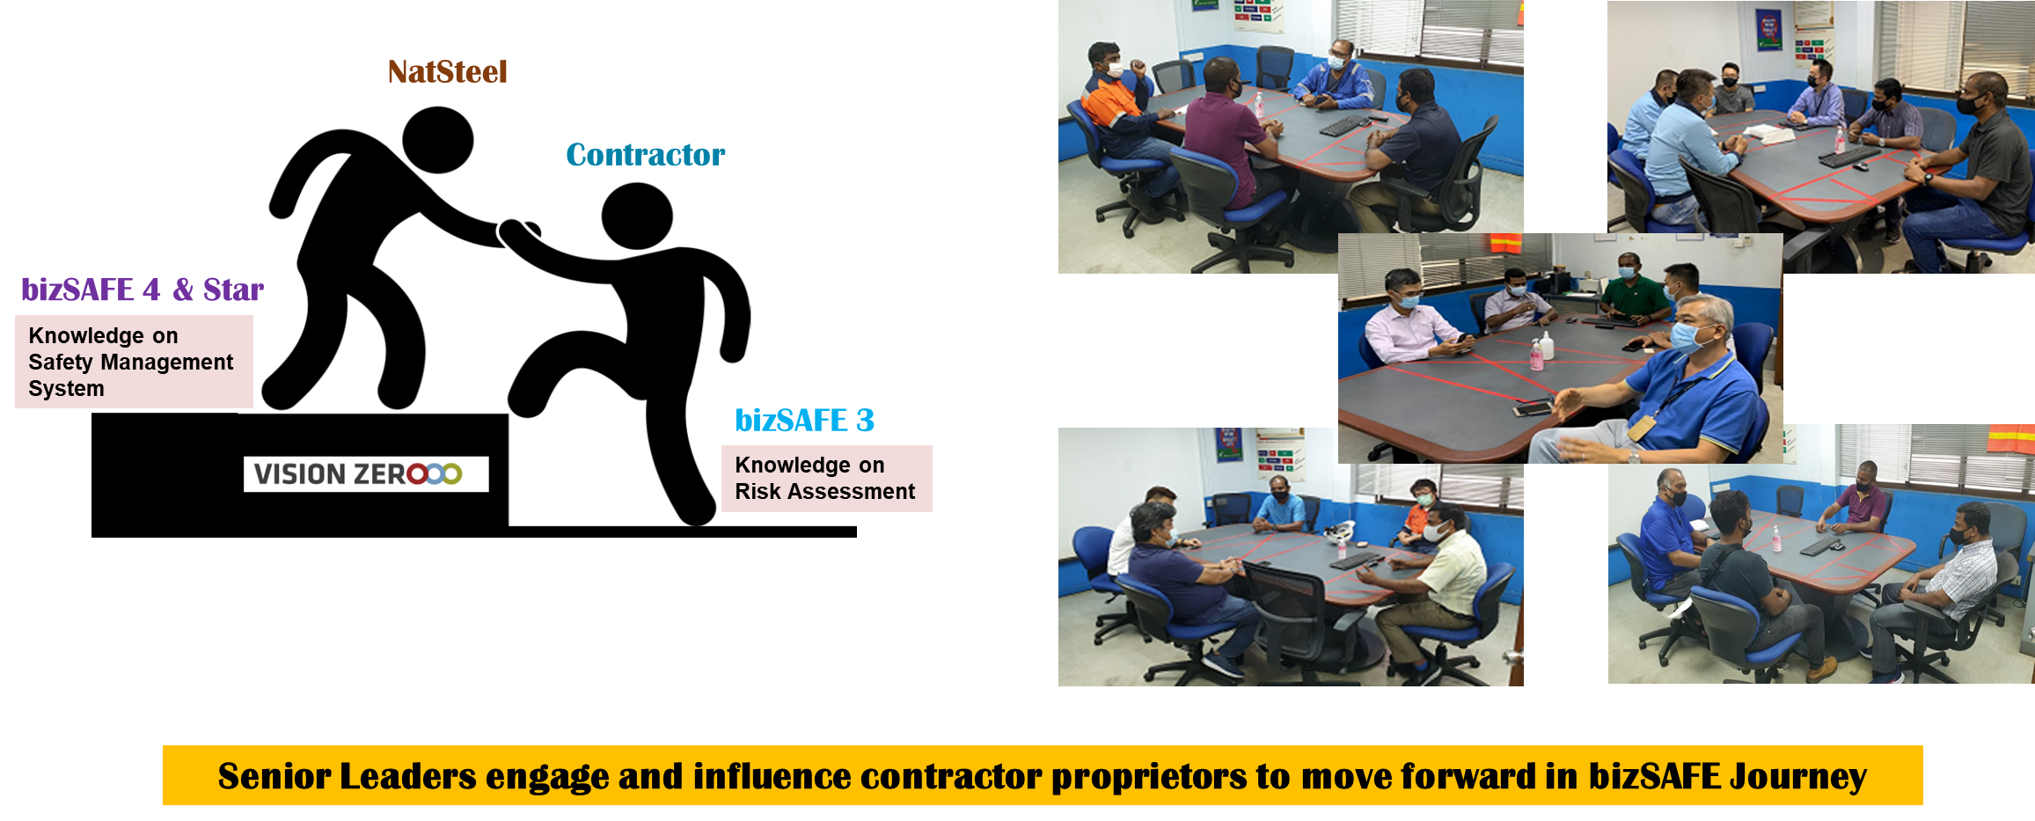
Nurturing Contractors: bizSAFE Briefing

Slide 28
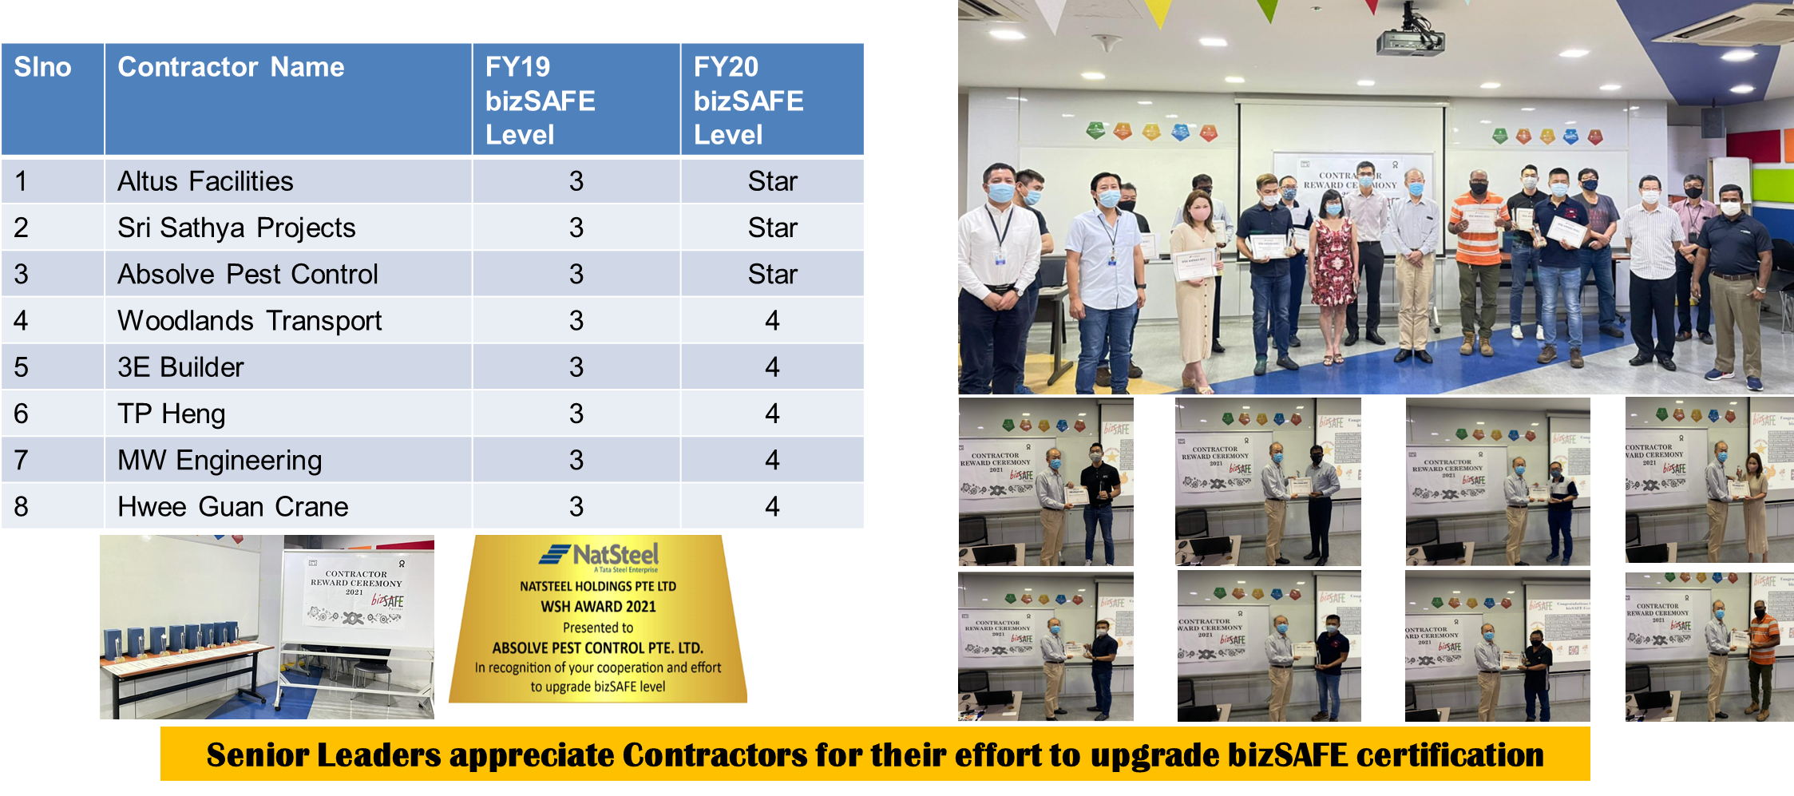
Nurturing Contractors:
Contractor Reward Ceremony

Slide 29
FY21 Key Accomplishments
NatSteel Recycling Received National bizSAFE Partner Award 2020
Completed National WSH initiatives
  NTU-WSHI Ownership Study
  Review of WSH Safety Management System for Metalworking Industry
  Safe machines Safe Hands Campaign
Formation of SMM committee and implementation of Safe Management Measures
Celebrated STEEL SAFETY DAY virtually followed by site audit lead by NLT and HODs
Organised Emergency Readiness Seminar Partnering with Fire Prevention Centre
Organised Virtual Road Safety Talk Partnering with Traffic Police
Conducted Operational Discipline with overall score improved
Conducted Safety Trainings for 250 Employees and Contractor

Slide 30
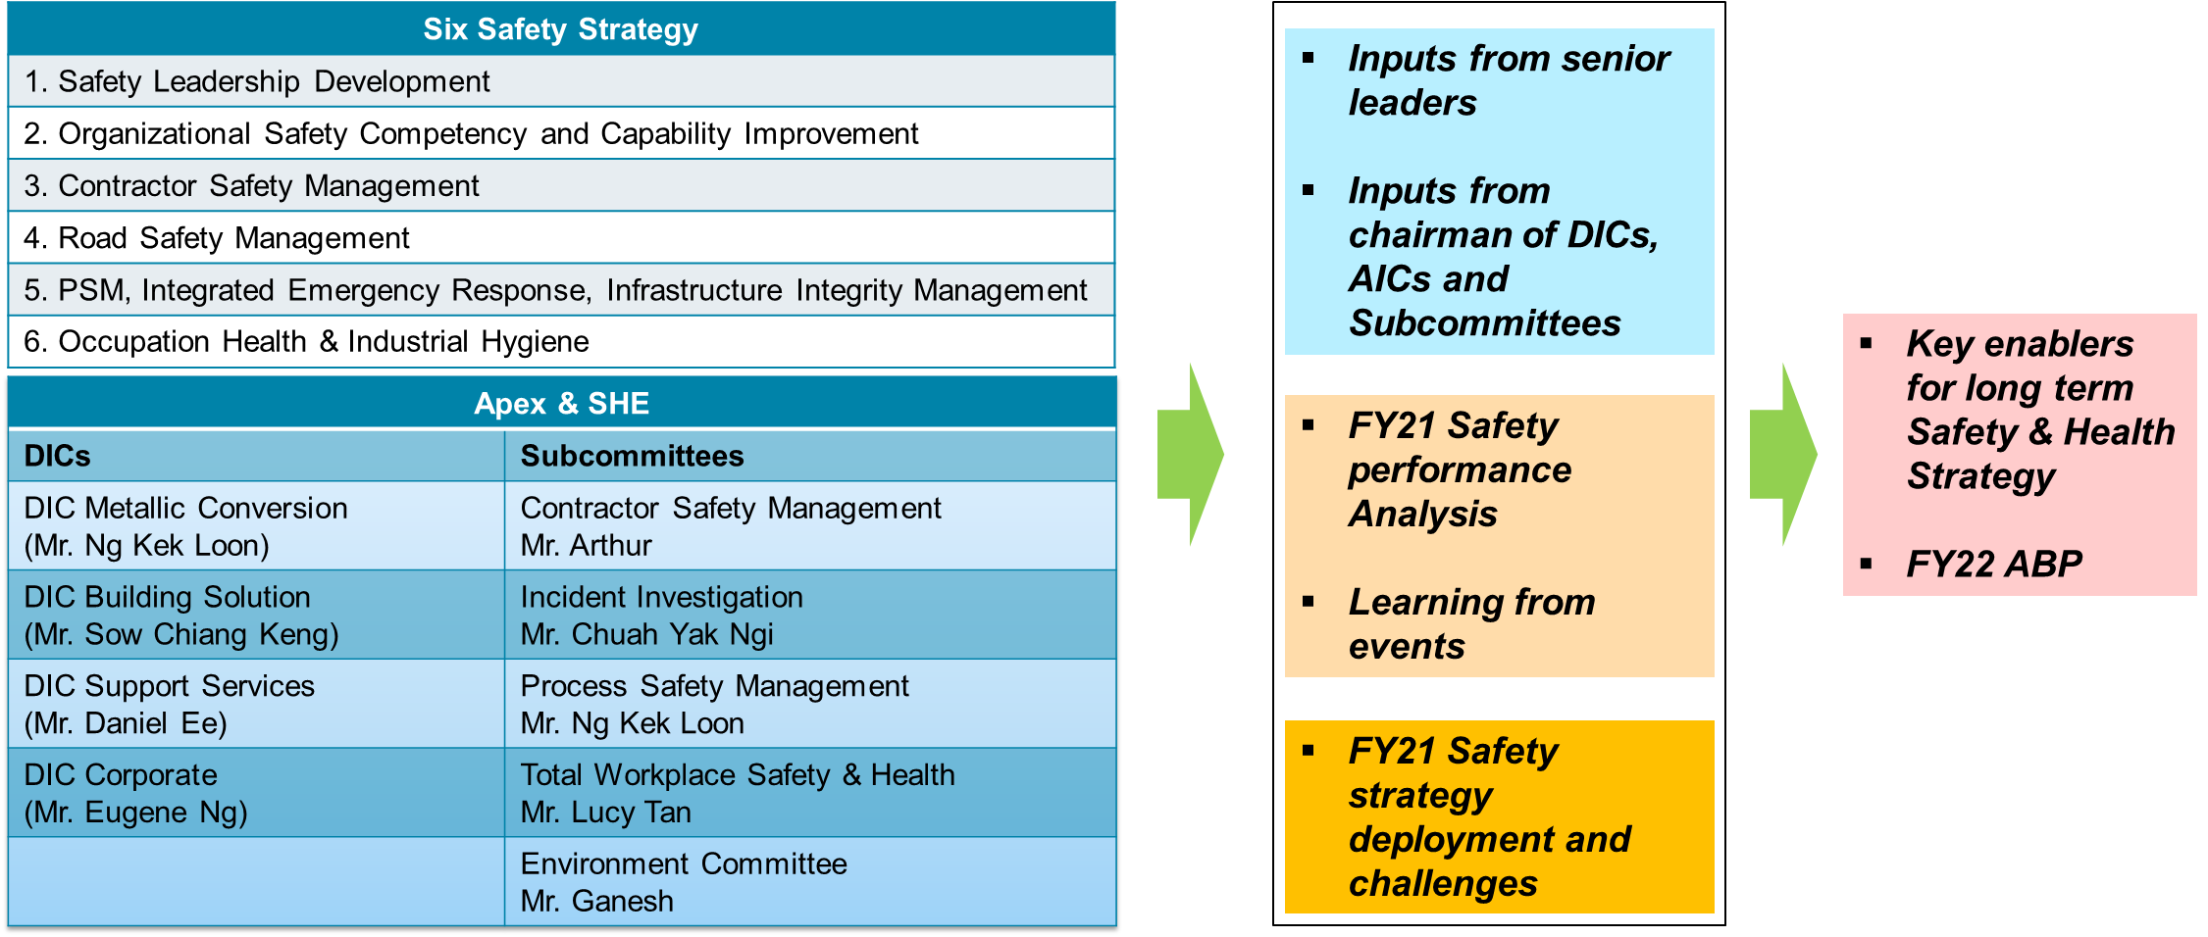
Safety & Health Long Term Strategies and
FY22 Safety ABP Formulation

Slide 31
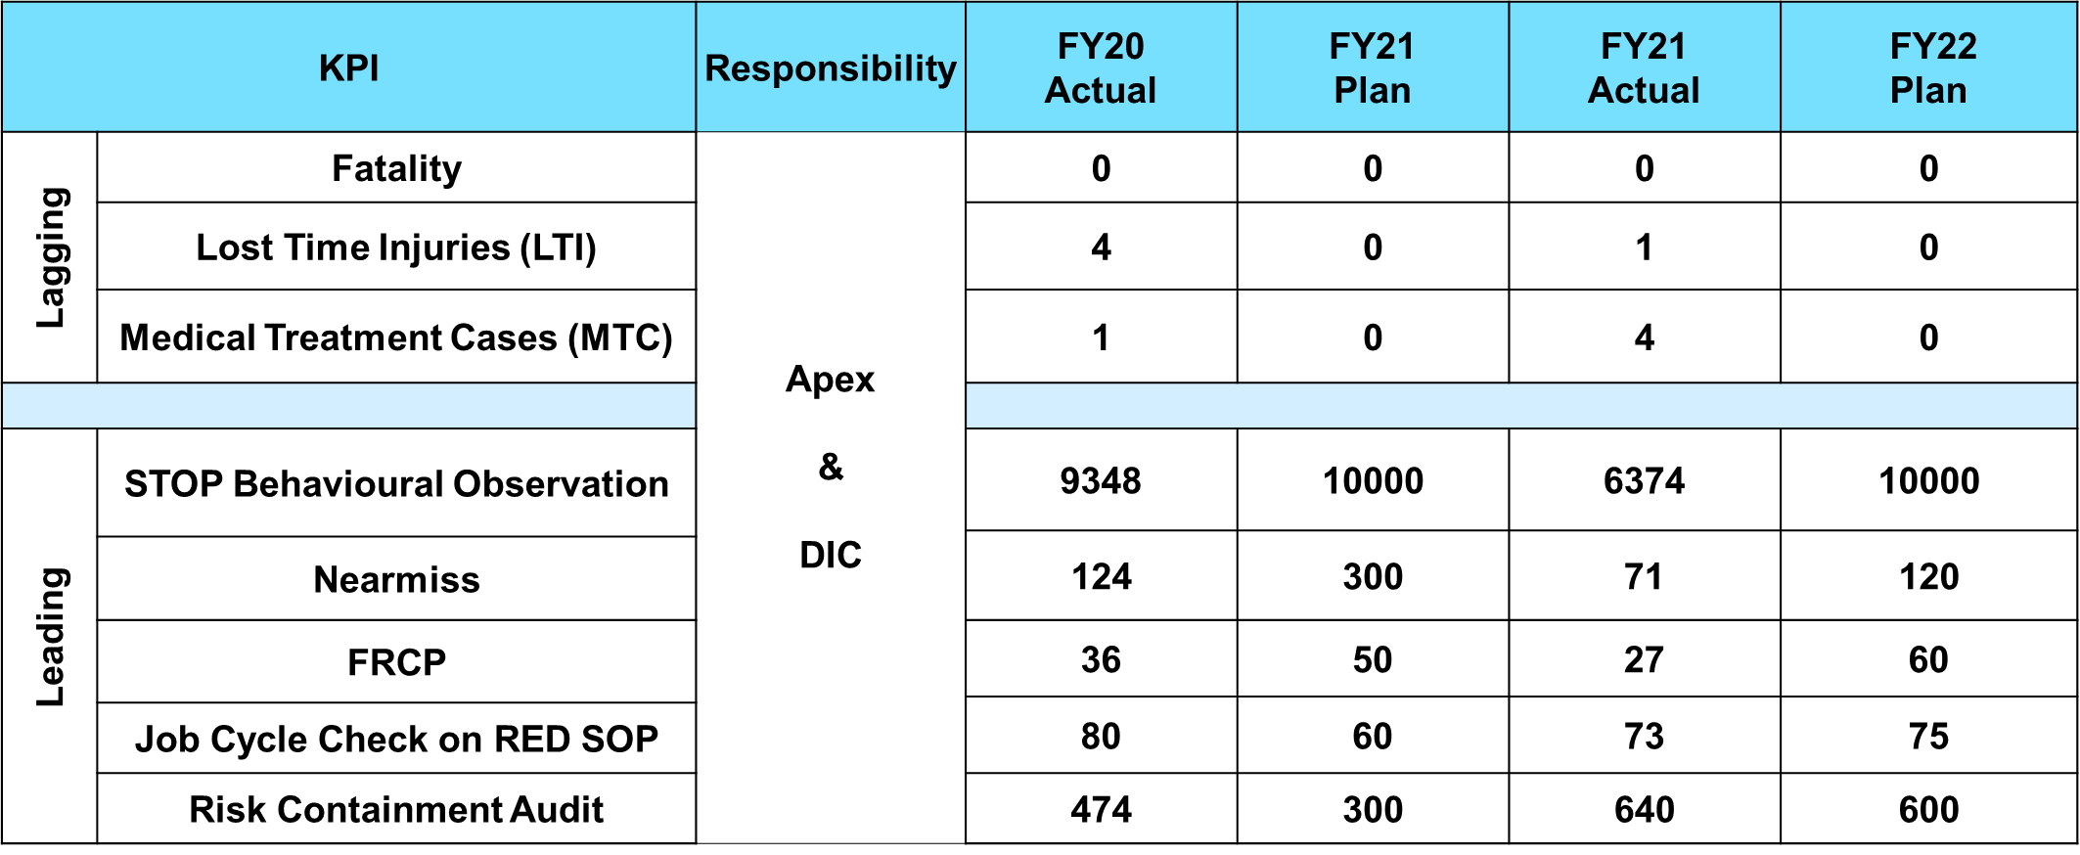
FY22 Safety Performance Dashboard

Slide 32
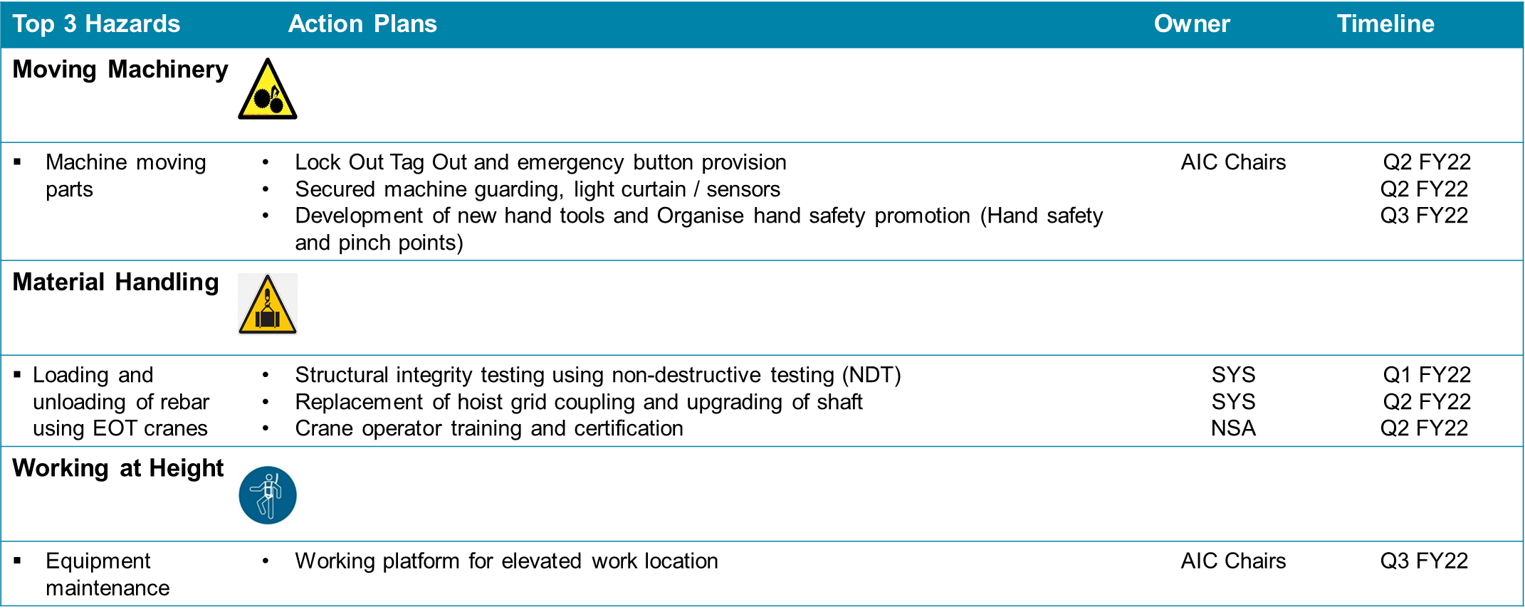
FY22 Safety ABP: DIC Building Solution

Slide 33
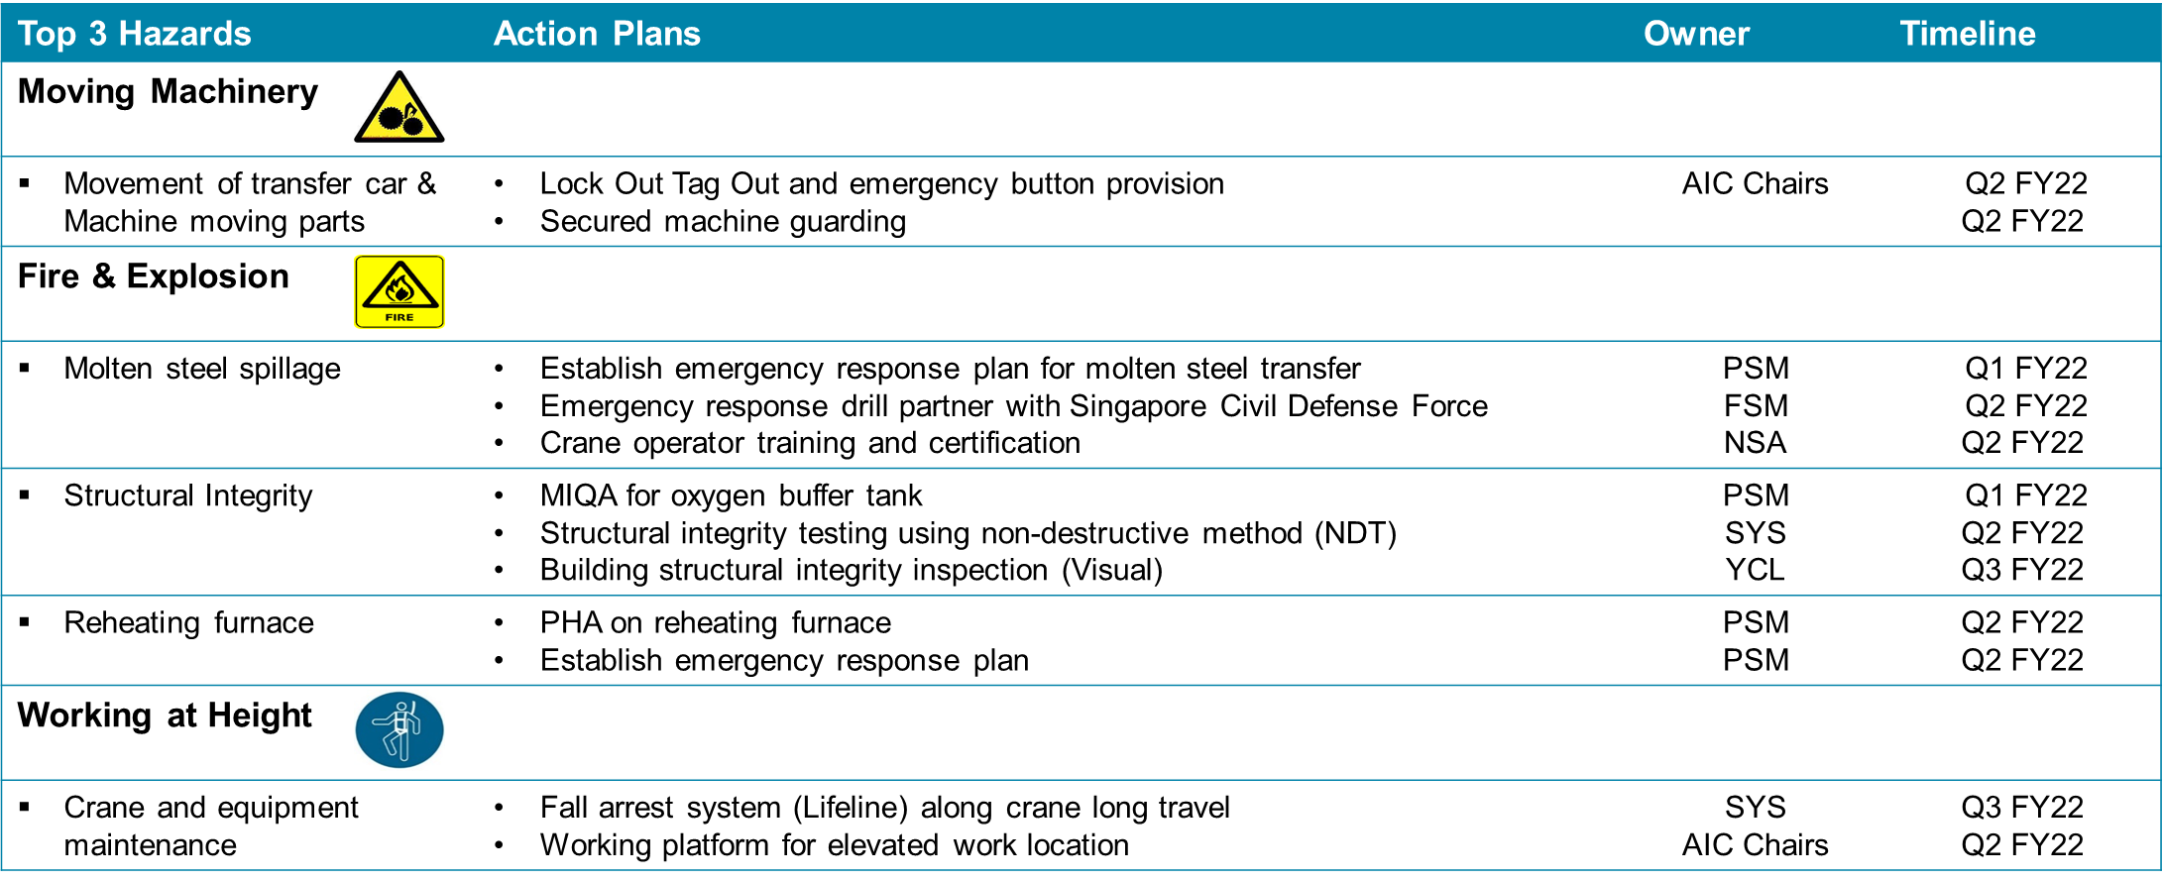
FY22 Safety ABP: DIC Metallic Conversion

Slide 34
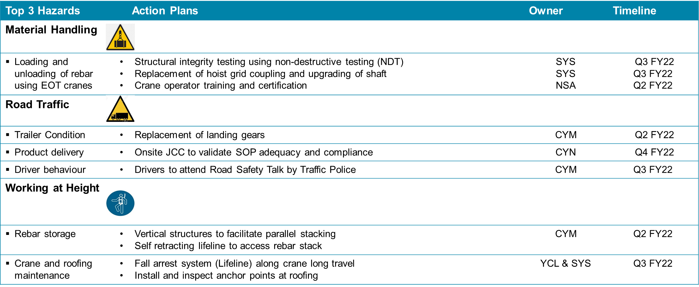
FY22 Safety ABP: DIC Support Services

Slide 35
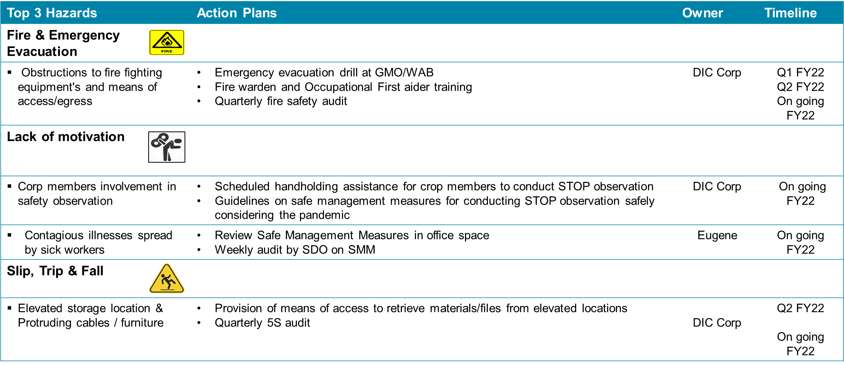
FY22 Safety ABP: DIC Corporate Services

Slide 36


FY22 Safety ABP

Slide 37


FY22 Safety ABP

Slide 38

FY22 Safety ABP

Slide 39

FY22 Safety ABP

Slide 40

FY22 Safety ABP:
Total WSH Wellness Calendar

Slide 41
FY22 SAFETY PERFORMANCE DASH BOARD
NSH Singapore - Leading Indicators - Sep 2021
Safety Observations | No.of STOP-Sep 21 |  | % Compliance-Sep 21 |  | STOP - FY22 YTD |  | %ComplianceFY22 YTD
 | Target | Actual | Target | Actual | Target | Actual | 113%
 | 535 | 582 | 100% | 109% | 3525 | 3982
RED SOP Job Cycle Checks | No.of JCC-Sep 21 |  | % Compliance-Sep 21 |  | JCC - FY22 YTD |  | 81%
 | Target | Actual | Target | Actual | Target | Actual
 | 6 | 4 | 100% | 67% | 36 | 29
Fatality Risk Identified | No.of FRCP Sep 21 |  | % Compliance-Sep 21 |  | FRCP - FY22 YTD |  | 67%
 | Target | Actual | Target | Actual | Target | Actual
 | 5 | 0 | 100% | 0% | 30 | 20
Risk Containment Audit | No.of RC Sep 21 |  | % Compliance-Sep 21 |  | RC - FY22 YTD |  | 157%
 | Target | Actual | Target | Actual | Target | Actual
 | 50 | 68 | 100% | 136% | 300 | 472
Nearmiss Incidences Reported | No.of NM Sep 21 |  | % Compliance-Sep 21 |  | NM - FY22 YTD |  | 98%
 | Target | Actual | Target | Actual | Target | Actual
 | 10 | 11 | 100% | 110% | 60 | 59
NSH Singapore - Lagging Indicators - Sep 2021
LTI(LTIF) NSH (S) | No.of LTI cases-Sep 21 |  | % Compliance-Sep 21 |  | LTI - FY22 YTD |  | MSP-2 CAB-1 MESH-1
 | Target | Actual | Target | Actual | Target | Actual
 | 0 | 0 | 100% | 100% | 0 | 4
MTC(MTCF) NSH (S) | No.of MTC cases-Sep 21 |  | % Compliance-Sep 21 |  | MTC - FY22 YTD |  | CAB-2 MESH-1
 | Target | Actual | Target | Actual | Target | Actual
 | 0 | 1 | 100% | 0% | 0 | 3

Slide 42







FY22 LEADING INDICATORS
Eliminating UC is crucial

Slide 43




FY22 LEADING INDICATORS
Provision of safe tools & equipment is mandatory
Strong focus on achieving excellent 5S

Slide 44

FY22 LEADING INDICATORS
Top risks are aligned, focused observation will help to improve further

Slide 45



FY22 LEADING INDICATORS
FATALITY POTENTIAL: Zero tolerance to work at height violations

Slide 46



FY22 LEADING INDICATORS
Focused observation with effective control measure will eliminate reoccurrence

Slide 47





FY22 LEADING INDICATORS
Eliminating UC is crucial

Slide 48




FY22 LEADING INDICATORS
Zero contractor LTI
FATALITY POTENTIAL: Zero tolerance towards severity 4 and 5 violations

Slide 49



FY22 H1 LAGGING INDICATORS
65% of the injuries are hand and finger related

Slide 50




FY22 H1 ACCIDENT TRIANGLE ANALYSIS
0
ZERO HARM
4
4
Leading
Indicators
40
4
MTC:3,FA:1
Unknown:
You can’t achieve good safety performance with weak leading indicators
400
59
4000
1373
STOP,FRCP,RC
68% of STOP observations are SA & SC
4 LTIs & 3 MTCs in FY22 H1
Fewer nearmisses reported

Slide 51

Benchmarking Safety Performance:
DUPONT Relative Culture Score

Slide 52

Benchmarking Safety Performance

Slide 53
THANK YOU

